Slide 1


Group 8 – Barter Trader
Alex Durling
Daniel Essien
Ella Morais
Fred Vincent
Jaelyn Cox
Junfa Li
William Li

Slide 2
User Stories
15 User Stories total
Well defined acceptance tests and engineering tasks
Each User Story completed within time constraints
Notes:
Ella

Slide 3



3 Main Features
Chat
Search
Notifications
Notes:
Ella

Slide 4

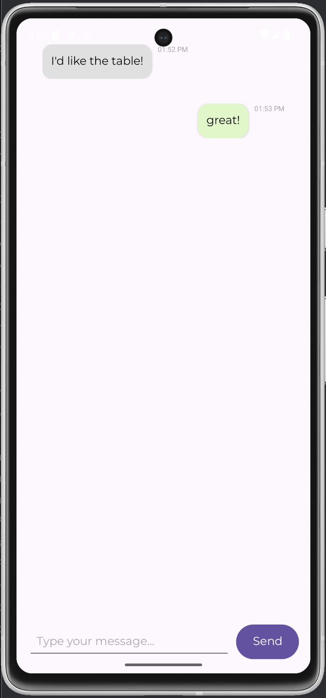
Chat
Importance
Communication between Providers and Receivers
Ease of Exchange
Related User Stories
Provider Received Offers Page
Offer Exchange Form for Receivers
Notes:
Junfa

Slide 5
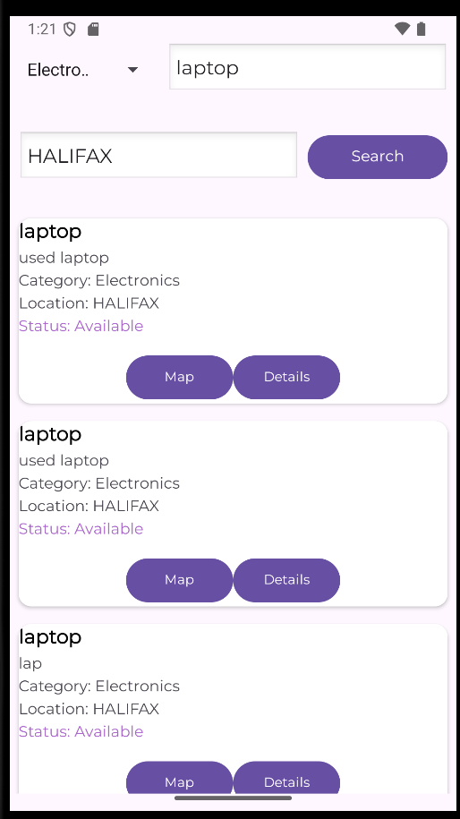
Search
Importance
Smooth Navigation and Query Processing
Simplicity in Accessing Information
Related User Stories
Product Details
View location on map
Notes:
William

Slide 6
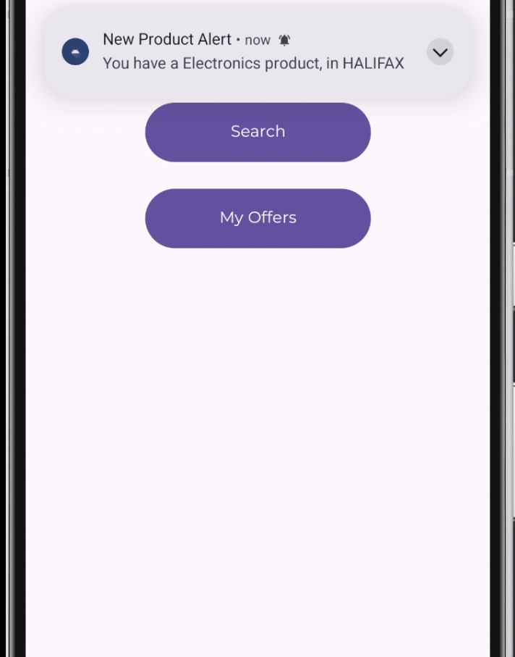
Notifications
Importance
Product Posting Reminders
Chat Initiation
Related User Stories
Product Details
Offer Exchange
Notes:
Daniel

Slide 7
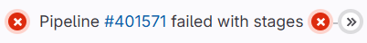
Achievements and Failures
Failures
Achievement
Some User Stories went beyond the allocated time frame
Minor bugs remaining
Burndown chart was not uniform throughout all three months
Completed all User Stories in the given time frame
Closed 96 issues on GitLab
Good attendance for all our Client TA meetings
Notes:
Alex

Slide 8
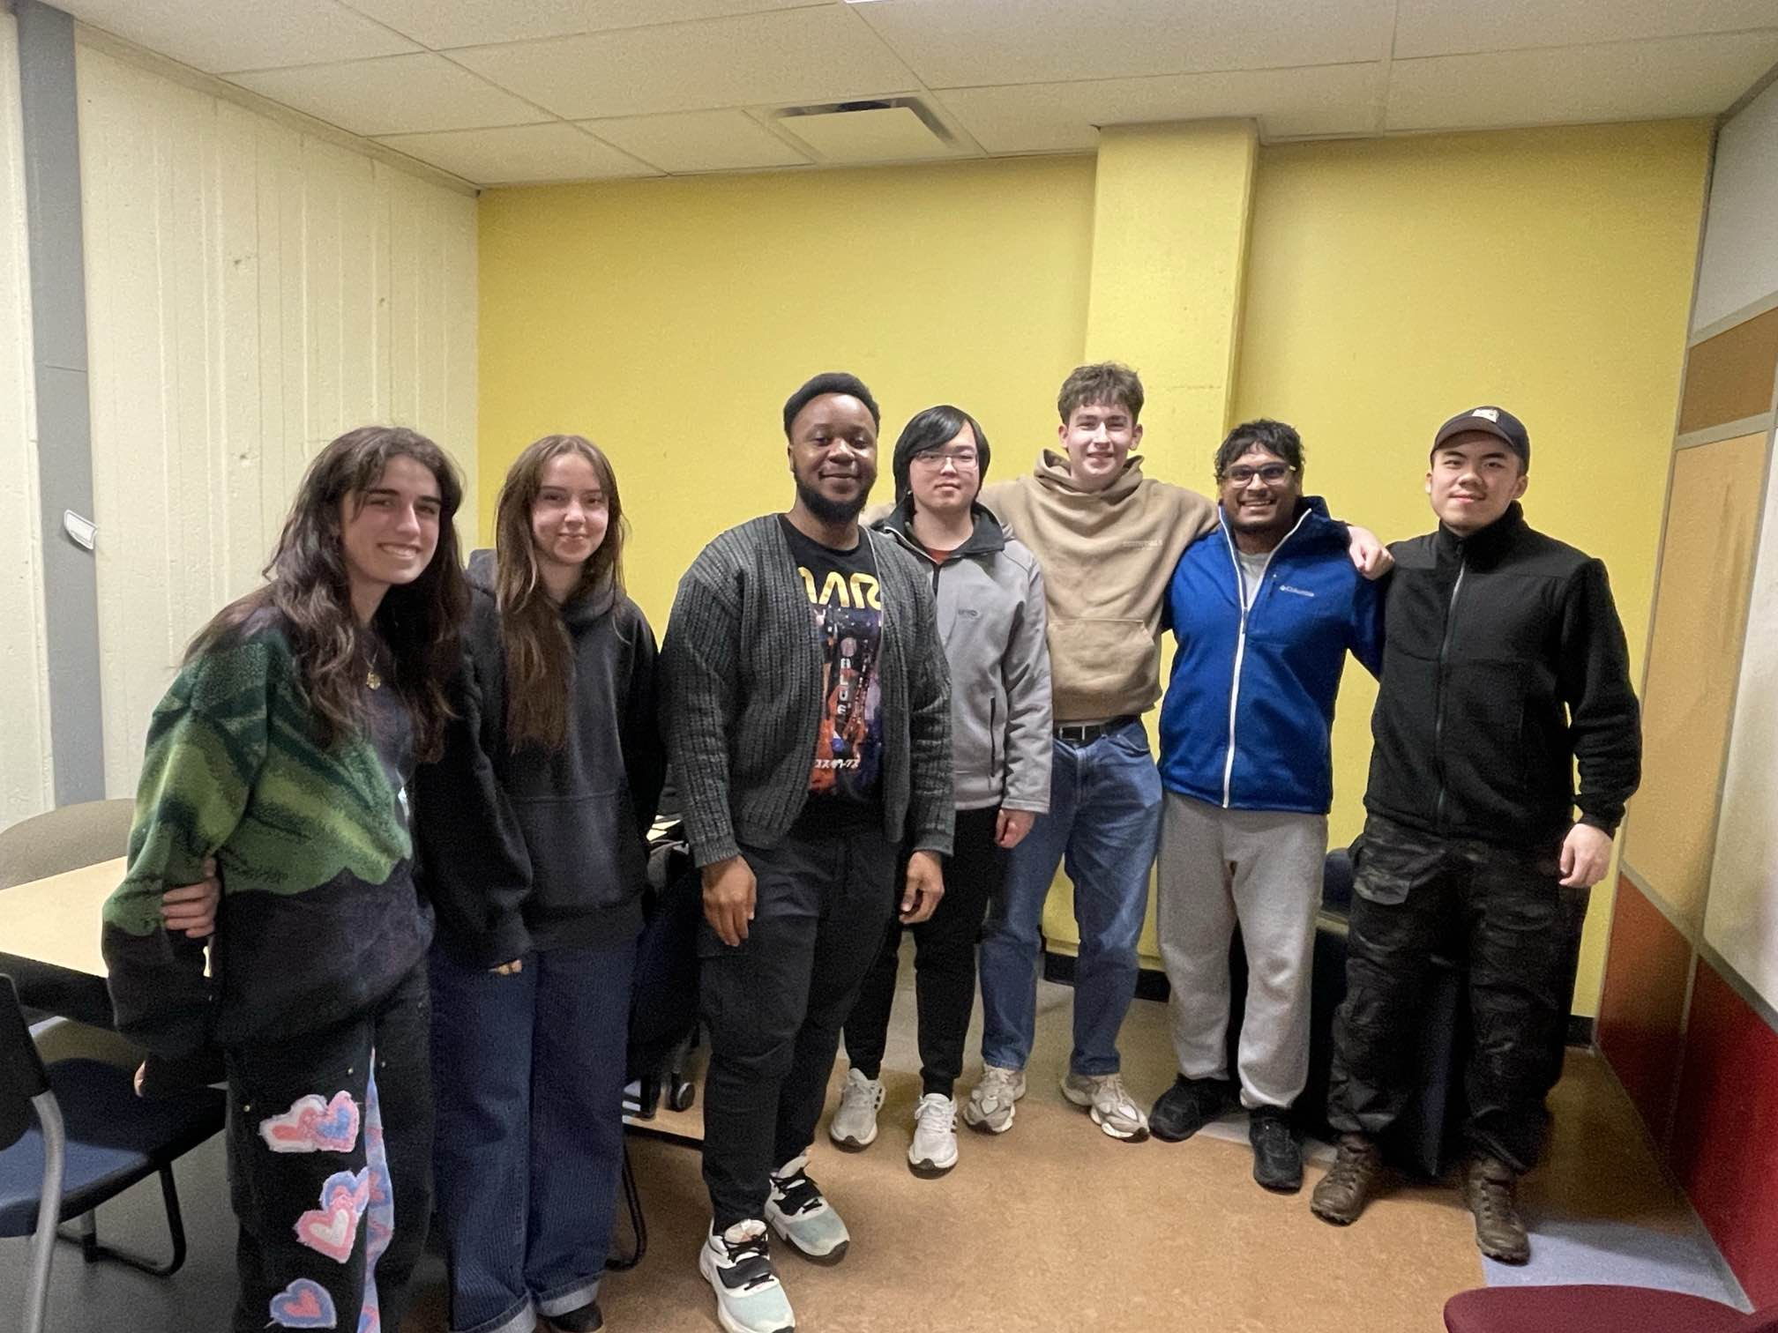
What Went Well
Implementation
Teamwork
Conflict Resolution
Firebase
Push Notification
Software Process:
Planning Game
Pair Programming
Notes:
Alex

Slide 9
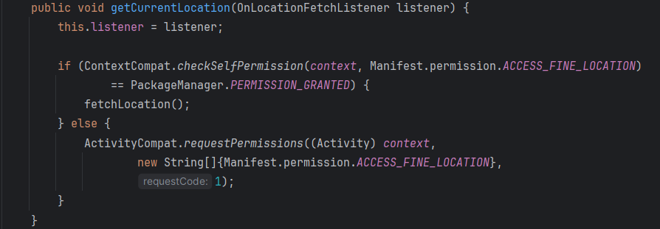
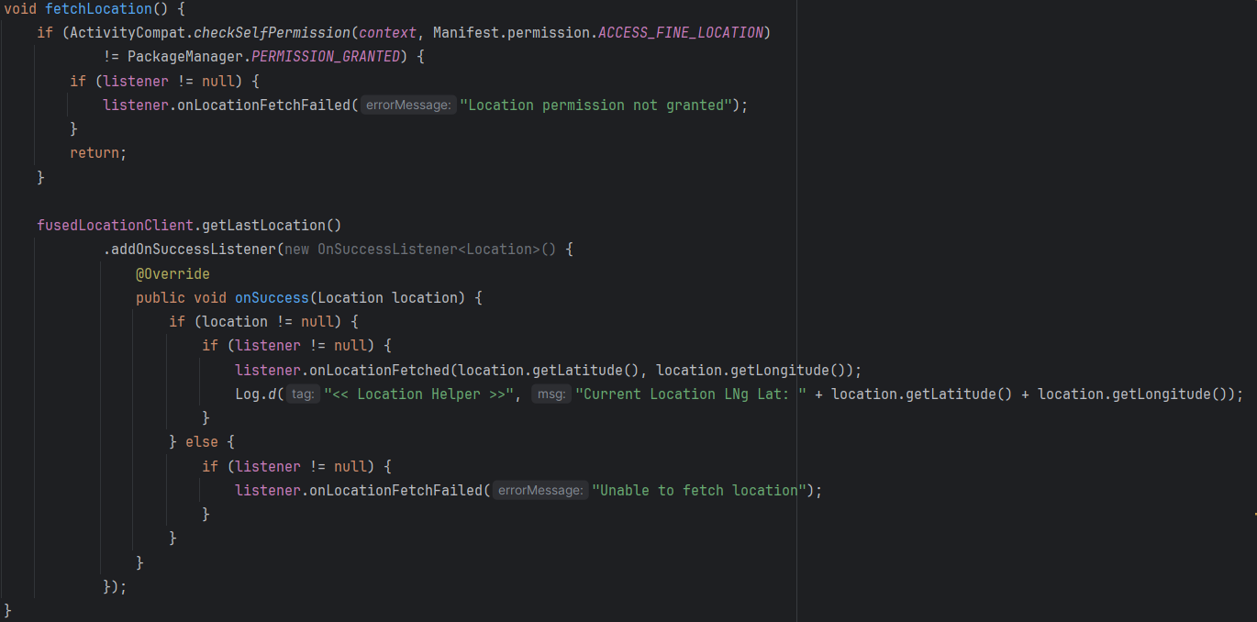
Challenges
Implementation
Merging Branches
Location Services
Software Process:
Test Writing
Continuous Integration
TDD
Notes:
Alex

Slide 10
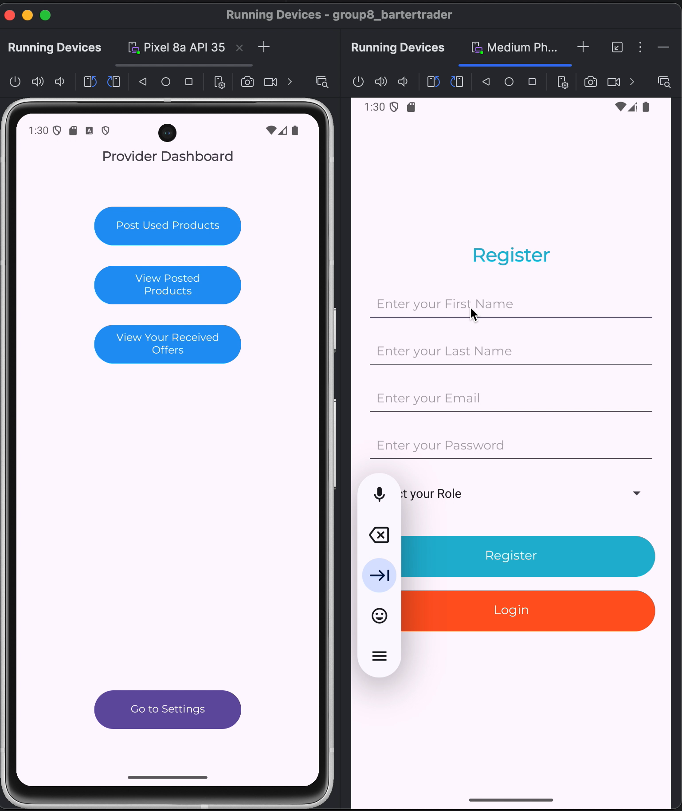
Demo
Notes:
Jae

